Slide 1
Foundations of Behavior
Chapter
14

Slide 2
L E A R N I N G O U T L I N E
Follow this Learning Outline as you read and study this chapter.
Why Look at Individual Behavior?
  Explain why the concept of an organization as an iceberg is important to understanding organizational behavior.
  Describe the focus and the goals of organizational behavior.
  Define the six important employee behaviors that managers want to explain, predict, and influence.
Attitudes
  Describe the three components of an attitude.
  Discuss three job-related attitudes.
  Describe the impact job satisfaction has on employee behavior.

Slide 3
L E A R N I N G O U T L I N E (cont’d)
Follow this Learning Outline as you read and study this chapter.
Attitudes (cont’d)
  Explain how individuals reconcile inconsistencies between attitudes and behavior.
Personality
  Contrast the MBTI and the big-five model of personality.
  Describe the five personality traits that have proved to be most powerful in explaining individual behavior in organizations.
  Explain how emotions and emotional intelligence impact behavior.

Slide 4
L E A R N I N G O U T L I N E (cont’d)
Follow this Learning Outline as you read and study this chapter.
Perception
  Explain how an understanding of perception can help managers.
  Describe the key elements of attribution theory.
  Discuss how the fundamental attribution error and self-serving bias can distort attributions.
  Name three shortcuts used in judging others.
Learning
  Explain how operant conditioning helps managers understand, predict, and influence behavior.
  Describe the implications of social learning theory for managing people at work.

Slide 5
L E A R N I N G O U T L I N E (cont’d)
Follow this Learning Outline as you read and study this chapter.
Learning (cont’d)
  Discuss how managers can shape behavior.
Contemporary OB Issues
  Describe the challenges managers face in managing Gen Y workers.
  Explain what managers can do to deal with workplace misbehavior.

Slide 6
Why Look at Individual Behavior?
Organizational Behavior (OB)
  The actions of people at work
Focus of Organizational Behavior
  Individual behavior
    Attitudes, personality, perception, learning, and motivation
  Group behavior
    Norms, roles, team building, leadership, and conflict
Goals of Organizational Behavior
  To explain, predict and influence behavior.

Slide 7
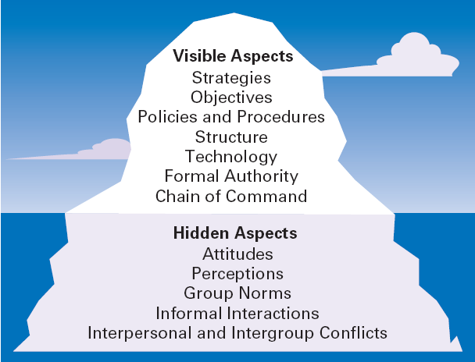
Exhibit 14.1 The Organization as an Iceberg

Slide 8

Important Employee Behaviors
Employee Productivity
  A performance measure of both efficiency and effectiveness
Absenteeism
  The failure to report to work when expected
Turnover
  The voluntary and involuntary
  permanent withdrawal from
  an organization

Slide 9
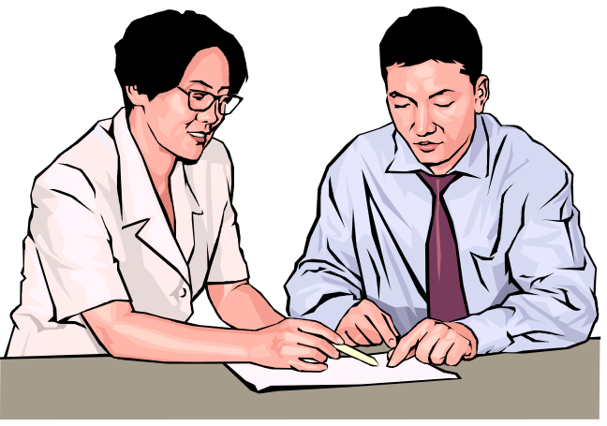
Important Employee Behaviors (cont’d)
Organizational Citizenship Behavior (OCB)
  Discretionary behavior that is not a part of an employee’s formal job requirements, but which promotes the effective functioning of the organization.
Job Satisfaction
  The individual’s general attitude
  toward his or her job

Slide 10
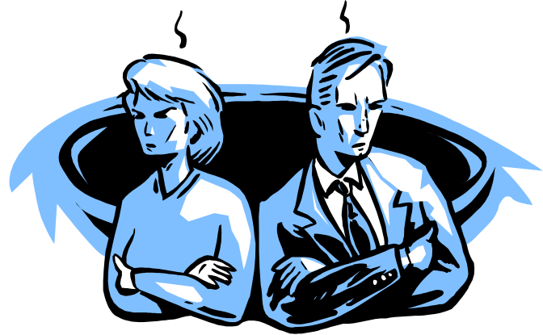
Important Employee Behaviors (cont’d)
Workplace Misbehavior
  Any intentional employee behavior that has negative consequences for the organization or individuals within the organization.
  Types of Misbehavior
    Deviance
    Aggression
    Antisocial behavior
    Violence

Slide 11
Psychological Factors Affecting Employee Behavior
Employee Productivity
Absenteeism
Turnover
Organizational Citizenship
Job Satisfaction
Workplace Misbehavior
Attitudes
Personality
Perception
Learning

Slide 12
Psychological Factors
Attitudes
  Evaluative statements—either favorable or unfavorable—concerning objects, people, or events.
Components Of An Attitude
  Cognitive component: the beliefs, opinions, knowledge, or information held by a person.
  Affective component: the emotional or feeling part of an attitude.
  Behavioral component: the intention to behave in a certain way.

Slide 13
Psychological Factors (cont’d)
Job Satisfaction
  Job satisfaction is affected by level of income earned and by the type of job a worker does.
Job Satisfaction and Productivity
  For individuals, productivity appears to lead to job satisfaction.
  For organizations, those with more satisfied employees are more effective than those with less satisfied employees.

Slide 14
Psychological Factors (cont’d)
Job Satisfaction and Absenteeism
  Satisfied employees tend to have lower levels of absenteeism.
Job Satisfaction and Turnover
  Satisfied employees have lower levels of turnover; dissatisfied employees have higher levels of turnover.
  Turnover is affected by the level of employee performance.
    The preferential treatment afforded superior employees makes satisfaction less important in predicting their turnover decisions.

Slide 15
Psychological Factors (cont’d)
Job Satisfaction and Customer Satisfaction
  The level of job satisfaction for frontline employees is related to increased customer satisfaction and loyalty.
  Interaction with dissatisfied customers can increase an employee’s job dissatisfaction.
  Actions to increase job satisfaction for customer service workers:
    Hire upbeat and friendly employees.
    Reward superior customer service.
    Provide a positive work climate.
    Use attitude surveys to track employee satisfaction.

Slide 16
Psychological Factors (cont’d)
Job Satisfaction and Workplace Misbehavior
  Dissatisfied employees will respond somehow
  Not easy to predict exactly how they’ll respond

Slide 17
Psychological Factors (cont’d)
Job Involvement
  The degree to which an employee identifies with his or her job, actively participates in it, and considers his or her performance to be important to his or her self-worth.
    High levels of commitment are related to fewer absences and lower resignation rates.

Slide 18
Psychological Factors (cont’d)
Organizational Commitment
  Is the degree to which an employee identifies with a particular organization and its goals and wishes to maintain membership in the organization.
  Leads to lower levels of both absenteeism and turnover.
  Could be becoming an outmoded measure as the number of workers who change employers increases.

Slide 19
Psychological Factors (cont’d)
Perceived Organizational Support
  Is the general belief of employees that their organization values their contribution and cares about their well-being.
  Represents the commitment of the organization to the employee.
  Providing high levels of support increases job satisfaction and lower turnover.

Slide 20
Attitudes and Consistency
People seek consistency in two ways:
  Consistency among their attitudes.
  Consistency between their attitudes and behaviors.
If an inconsistency arises, individuals:
  Alter their attitudes
  or
  Alter their behavior
  or
  Develop a rationalization for the inconsistency

Slide 21
Cognitive Dissonance Theory
Cognitive Dissonance
  Any incompatibility or inconsistency between attitudes or between behavior and attitudes.
    Any form of inconsistency is uncomfortable and individuals will try to reduce the dissonance.
  The intensity of the desire to reduce the dissonance is influenced by:
    The importance of the factors creating the dissonance.
    The degree to which an individual believes that the factors causing the dissonance are controllable.
    Rewards available to compensate for the dissonance.

Slide 22
Attitude Surveys
Attitude Surveys
  A instrument/document that presents employees with a set of statements or questions eliciting how they feel about their jobs, work groups, supervisors, or their organization.
  Provide management with feedback on employee perceptions of the organization and their jobs.

Slide 23
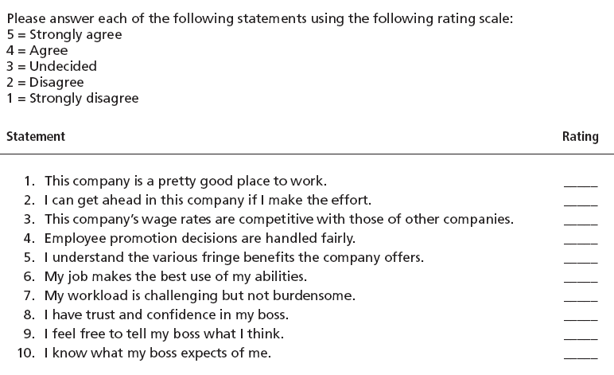
Exhibit 14.2 Sample Attitude Survey
Source: Based on T. Lammers, “The Essential Employee Survey,” Inc., December 1992, pp. 159–161.

Slide 24
The Importance of Attitudes
Implication for Managers
  Attitudes warn of potential behavioral problems:
    Managers should do things that generate the positive attitudes that reduce absenteeism and turnover.
  Attitudes influence behaviors of employees:
    Managers should focus on helping employees become more productive to increase job satisfaction.
  Employees will try to reduce dissonance unless:
    Managers identify the external sources of dissonance.
    Managers provide rewards compensating for the dissonance.

Slide 25
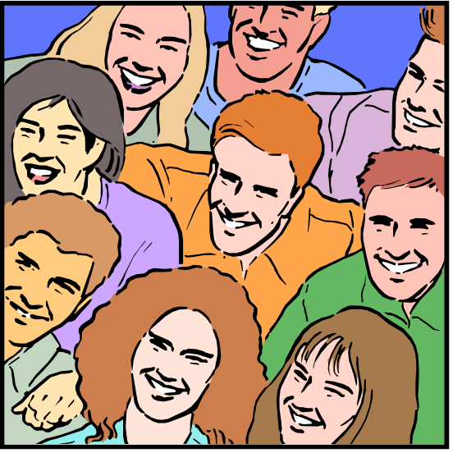
Personality
Personality
  The unique combination of psychological characteristics (measurable traits) that affect how a person reacts and interacts with others.

Slide 26
Classifying Personality Traits
Myers Briggs Type Indicator (MBTI®)
  A general personality assessment tool that measures the personality of an individual using four categories:
    Social interaction: Extrovert or Introvert (E or I)
    Preference for gathering data: Sensing or Intuitive (S or N)
    Preference for decision making: Feeling or Thinking (F or T)
    Style of decision making: Perceptive or Judgmental (P or J)

Slide 27
Exhibit 14.3 Examples of MBTI® Types
Type | Description
INFJ (introvert, intuitive, feeling, judgmental) | Quietly forceful, conscientious, and concerned for others. Such people succeed by perseverance, originality, and the desire to do whatever is needed or wanted. They are often highly respected for their uncompromising principles.
ESTP (extrovert, sensing, thinking, perceptive) | Blunt and sometimes insensitive. Such people are matter-of-fact and do not worry or hurry. They enjoy whatever comes along. They work best with real things that can be assembled or disassembled.
ISFP (introvert, sensing, feeling, perceptive) | Sensitive, kind, modest, shy, and quietly friendly. Such people strongly dislike disagreements and will avoid them. They are loyal followers and quite often are relaxed about getting things done.
ENTJ (extrovert, intuitive, thinking, judgmental) | Warm, friendly, candid, and decisive; also usually skilled in anything that requires reasoning and intelligent talk, but may sometimes overestimate what they are capable of doing.
Source: Based on I. Briggs-Myers, Introduction to Type (Palo Alto, CA: Consulting Psychologists Press, 1980), pp. 7–8.

Slide 28
The Big-Five Model
Extraversion
  Sociable, talkative, and assertive
Agreeableness
  Good-natured, cooperative, and trusting
Conscientiousness
  Responsible, dependable, persistent, and achievement oriented
Emotional Stability
  Calm, enthusiastic, and secure or tense, nervous, and insecure
Openness to Experience
  Imaginative, artistically sensitive, and intellectual

Slide 29
Other Personality Insights
Locus of Control
  Internal locus: persons who believe that they control their own destiny.
  External locus: persons who believe that what happens to them is due to luck or chance (the uncontrollable effects of outside forces) .
Machiavellianism (Mach)
  The degree to which an individual is pragmatic, maintains emotional distance, and seeks to gain and manipulate power—ends can justify means.

Slide 30
Other Personality Insights (cont’d)
Self-Esteem (SE)
  The degree to which people like or dislike themselves
  High SEs
    Believe in themselves and expect success.
    Take more risks and use unconventional approaches.
    Are more satisfied with their jobs than Low SEs.
  Low SEs
    Are more susceptible to external influences.
    Depend on positive evaluations from others.
    Are more prone to conform than high SEs.

Slide 31
Other Personality Insights (cont’d)
Self-Monitoring
  An individual’s ability to adjust his or her behavior to external, situational factors.
  High self-monitors:
    Are sensitive to external cues and behave differently in different situations.
    Can present contradictory public persona and private selves—impression management.
  Low self-monitors
    Do not adjust their behavior to the situation.
    Are behaviorally consistent in public and private.

Slide 32
Other Personality Insights (cont’d)
Risk-Taking
  The propensity (or willingness) to take risks.
    High risk-takers take less time and require less information than low risk-takers when making a decision.
  Organizational effectiveness is maximized when the risk-taking propensity of a manager is aligned with the specific demands of the job assigned to the manager.

Slide 33


Emotions
Emotions
  Intense feelings (reactions) that are directed at specific objects (someone or something)
  Universal emotions:
    Anger
    Fear
    Sadness
    Happiness
    Disgust
    Surprise

Slide 34
Emotional Intelligence
Emotional Intelligence (EI)
  An assortment of noncognitive skills, capabilities, and competencies that influence a person’s ability to succeed in coping with environmental demands and pressures.
  Dimensions of EI:
    Self-awareness: knowing what you’re feeling
    Self-management: managing emotions and impulses
    Self-motivation: persisting despite setbacks and failures
    Empathy: sensing how others are feeling
    Social skills: handling the emotions of others

Slide 35
Implications for Managers
Employee selection
Helps in understanding employee behavior(s)
By understanding others’ behavior(s), can work better with them

Slide 36
Understanding Personality Differences
Personality-Job Fit Theory (Holland)
  An employee’s job satisfaction and likelihood of turnover depends on the compatibility of the employee’s personality and occupation.
  Key points of the theory:
    There are differences in personalities.
    There are different types of jobs.
    Job satisfaction and turnover are related to the match between personality and job for an individual.

Slide 37
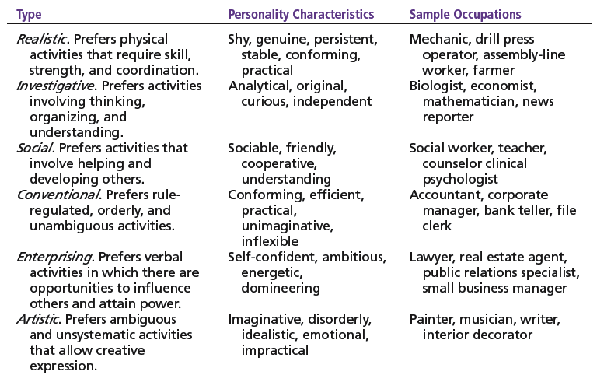
Exhibit 14.4 Holland’s Typology of Personality and Sample Occupations
Source: Based on J. L. Holland, Making Vocational Choices: A Theory of Vocational Personalities and Work Environments (Odessa, FL: Psychological Assessment Resources, 1997).

Slide 38
Perception
Perception
  A process by which individuals give meaning (reality) to their environment by organizing and interpreting their sensory impressions.
Factors influencing perception:
  The perceiver’s personal characteristics—interests, biases and expectations
  The target’s characteristics—distinctiveness, contrast, and similarity)
  The situation (context) factors—place, time, location—draw attention or distract from the target

Slide 39
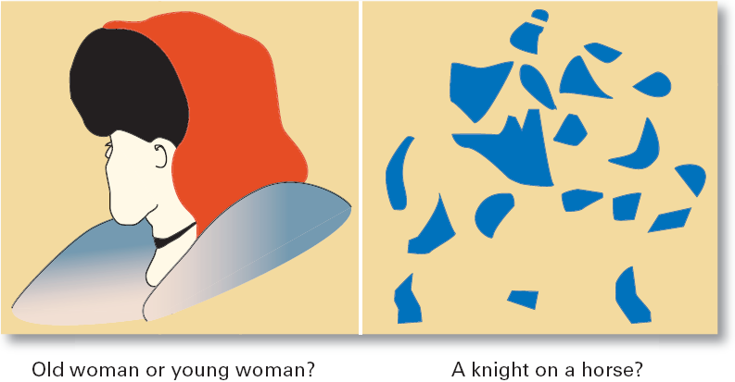
Exhibit 14.5 Perception Challenges: What Do You See?

Slide 40
How We Perceive People
Attribution Theory
  How the actions of individuals are perceived by others depends on what meaning (causation) we attribute to a given behavior.
    Internally caused behavior: under the individual’s control
    Externally caused behavior: due to outside factors
  Determining the source of behaviors:
    Distinctiveness: different behaviors in different situations
    Consensus: behaviors similar to others in same situation
    Consistency: regularity of the same behavior over time

Slide 41
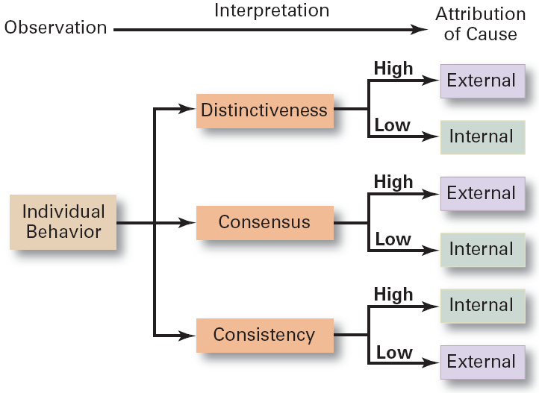
Exhibit 14.6 Attribution Theory

Slide 42
How We Perceive People (cont’d)
Attribution Theory – errors and biases (cont’d)
  Fundamental attribution error
    The tendency to underestimate the influence of external factors and to overestimate the influence of internal or personal factors.
  Self-serving bias
    The tendency of individuals to attribute their successes to internal factors while blaming personal failures on external factors.

Slide 43
Shortcuts Used in Judging Others
Assumed Similarity
  Assuming that others are more like us than they actually are.
Stereotyping
  Judging someone on the basis of our perception of a group he or she is a part of.
Halo Effect
  Forming a general impression of a person on the basis of a single characteristic of that person

Slide 44
Implications for Managers
Employees react to perceptions
Pay close attention to how employees perceive their jobs and management actions

Slide 45
Learning
Learning
  Any relatively permanent change in behavior that occurs as a result of experience.
    Almost all complex behavior is learned.
    Learning is a continuous, life-long process.
    The principles of learning can be used to shape behavior
Theories of learning:
  Operant conditioning
  Social learning

Slide 46
Learning (cont’d)
Operant Conditioning (B.F. Skinner)
  The theory that behavior is a function of its consequences and is learned through experience.
  Operant behavior: voluntary or learned behaviors
    Behaviors are learned by making rewards contingent to behaviors.
    Behavior that is rewarded (positively reinforced) is likely to be repeated.
    Behavior that is punished or ignored is less likely to be repeated.

Slide 47
Learning (cont’d)
Social Learning
  The theory that individuals learn through their observations of others and through their direct experiences.
  Attributes of models that influence learning:
    Attentional: the attractiveness or similarity of the model
    Retention: how well the model can be recalled
    Motor reproduction: the reproducibility of the model’s actions
    Reinforcement: the rewards associated with learning the model behavior

Slide 48
Shaping: A Managerial Tool
Shaping Behavior
  Attempting to “mold” individuals by guiding their learning in graduated steps such that they learn to behave in ways that most benefit the organization.
  Shaping methods:
    Positive reinforcement: rewarding desired behaviors.
    Negative reinforcement: removing an unpleasant consequence once the desired behavior is exhibited.
    Punishment: penalizing an undesired behavior.
    Extinction: eliminating a reinforcement for an undesired behavior.

Slide 49

Contemporary Issues in OB
Managing Generational Differences in the Workplace
  Gen Y: individuals born after 1978
    Bring new attitudes to the workplace that reflect wide arrays of experiences and opportunities
    Want to work, but don’t want work to be their life
    Challenge the status quo
    Have grown up with technology

Slide 50
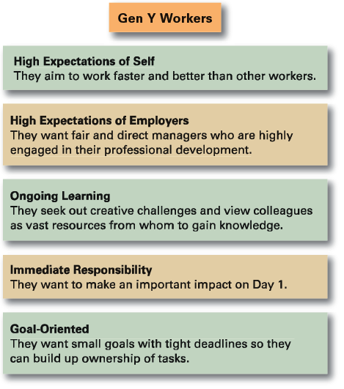
Exhibit 14.7 Gen Y Workers
Source: Bruce Tulgan of Rainmaker Thinking. Used with permission.

Slide 51
Contemporary Issues in OB
Managing Negative Behavior in the Workplace
  Tolerating negative behavior sends the wrong message to other employees
  Both preventive and responsive actions to negative behaviors are needed:
    Screening potential employees
    Responding immediately and decisively to unacceptable behavior
    Paying attention to employee attitudes

Slide 52
Terms to Know
behavior
organizational behavior
employee productivity
absenteeism
turnover
organizational citizenship behavior
job satisfaction
workplace misbehavior
attitudes
cognitive component
affective component
behavioral component
job involvement
organizational commitment
perceived organizational support
cognitive dissonance
attitude surveys
personality
big-five model
locus of control
Machiavellianism

Slide 53
Terms to Know (cont’d)
self-esteem
self-monitoring
impression management
emotions
emotional intelligence (EI)
perception
attribution theory
fundamental attribution error
self-serving bias
assumed similarity
stereotyping
halo effect
learning
operant conditioning
social learning theory
shaping behavior

